Slide 1


Botnet Detection by Integrating Multiple Machine Learning Models
Thanawat Tejapijaya
Prarinya Siritanawan
Karin Sumongkayothin
Kazunori Kotani
ICISSP 10th Conference

Slide 2
Content
Introduction
Problem
Method
Experimental setup
Result
Conclusion

Slide 3
Introduction
A botnet is a collection of computers that have fallen victim to malware. It enables a single, malevolent individual, often referred to as a "botmaster," to manipulate the computers from a distance.
Botnet represents one of the most aggressive cyber-attack threats. They are characterized by their elusive nature and evolving behaviors.
Their ability to operate stealthily on a massive scale poses challenges to conventional security monitoring systems like Security Information and Event Management (SIEM).

Slide 4
Problem
Challenges persist in achieving low false negative rates for detecting various botnet behaviors.

Slide 5
Method
Data preparation
Feature Extraction
Individual models training
Classification by individual models
Integration methods
Evaluation
Conduct an experiments

Slide 6
Data preparation
Extract attribute of NetFlow file into 2 attribute types
Numerical attribute is attribute that contain data that can be used directly for calculations such as integers and floats.
Categorical attribute is attribute that contain non-numerical data and cannot be used directly for calculations.

Slide 7
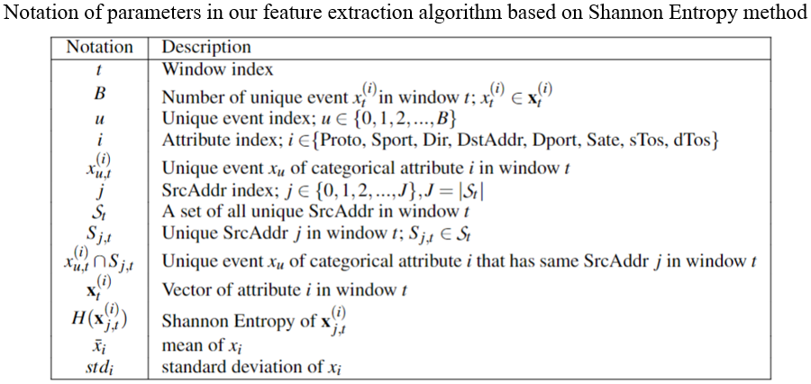
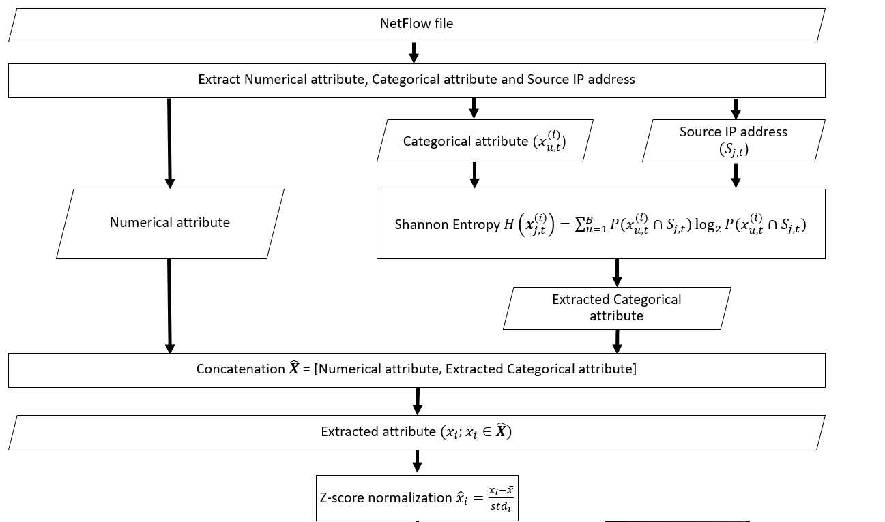
Feature Extraction
We used Shannon Entropy to do feature extraction on categorical attribute.
Then, we concatenate Numerical attribute and extracted categorical attribute.
Z-score normalization was used on Extracted attribute.

Slide 8
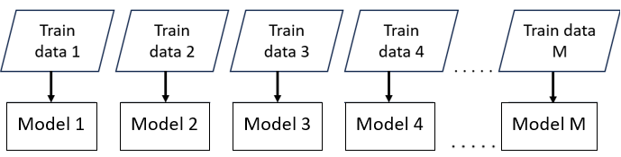
Individual models training
Divide extracted data that got from feature extraction into Train set (80%) and Test set (20%)
Each Model will be trained independently, one scenario per one model.
Individual models training process

Slide 9
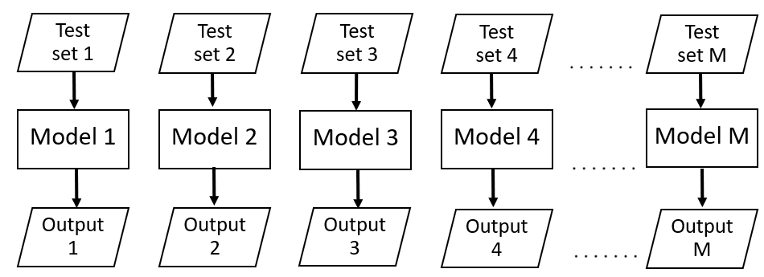
Classification by individual models
Each model will be tested independently.
1 model will be tested for M time.
Individual models testing process

Slide 10
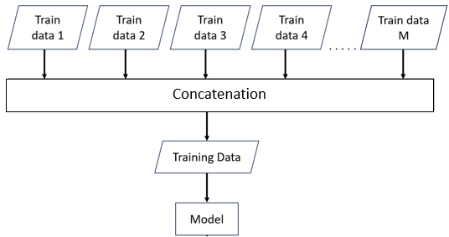
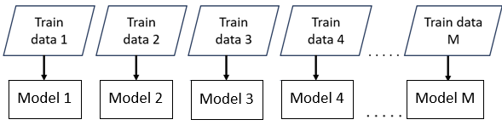
Integration method (training process)
We utilized 2 integrating techniques
1. Late Integration (our proposed method) –
We used model that was trained in individual models training.
2. Early Integration – We concatenated training set together before train a model.
Late integration training process
Early integration training process
Same training data were used on both technique.

Slide 11
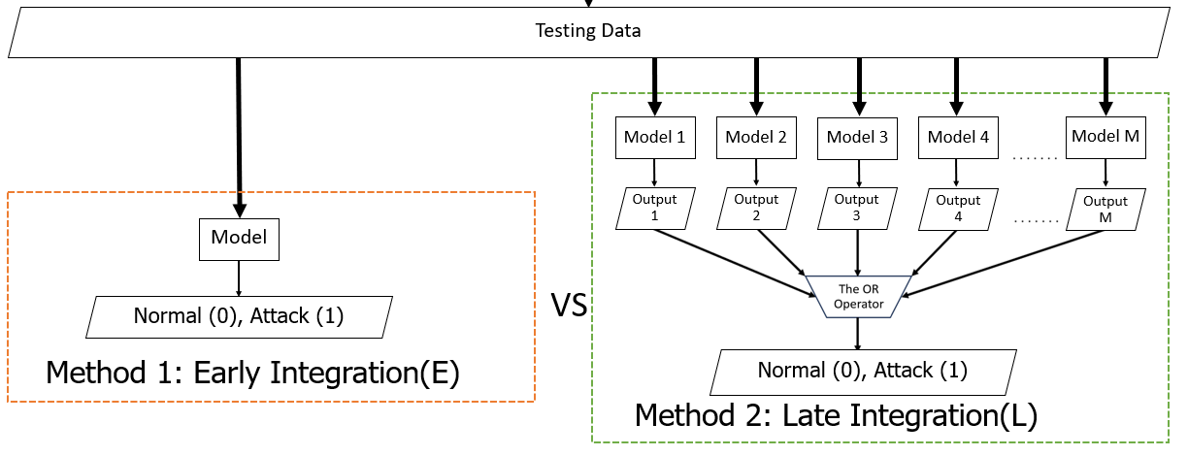
Integration method (testing process)
For late integration, testing data will be an input for every model. Then, we integrated every output with the OR operator to predict one result.
Testing process

Slide 12
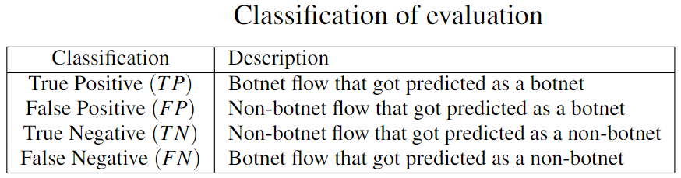
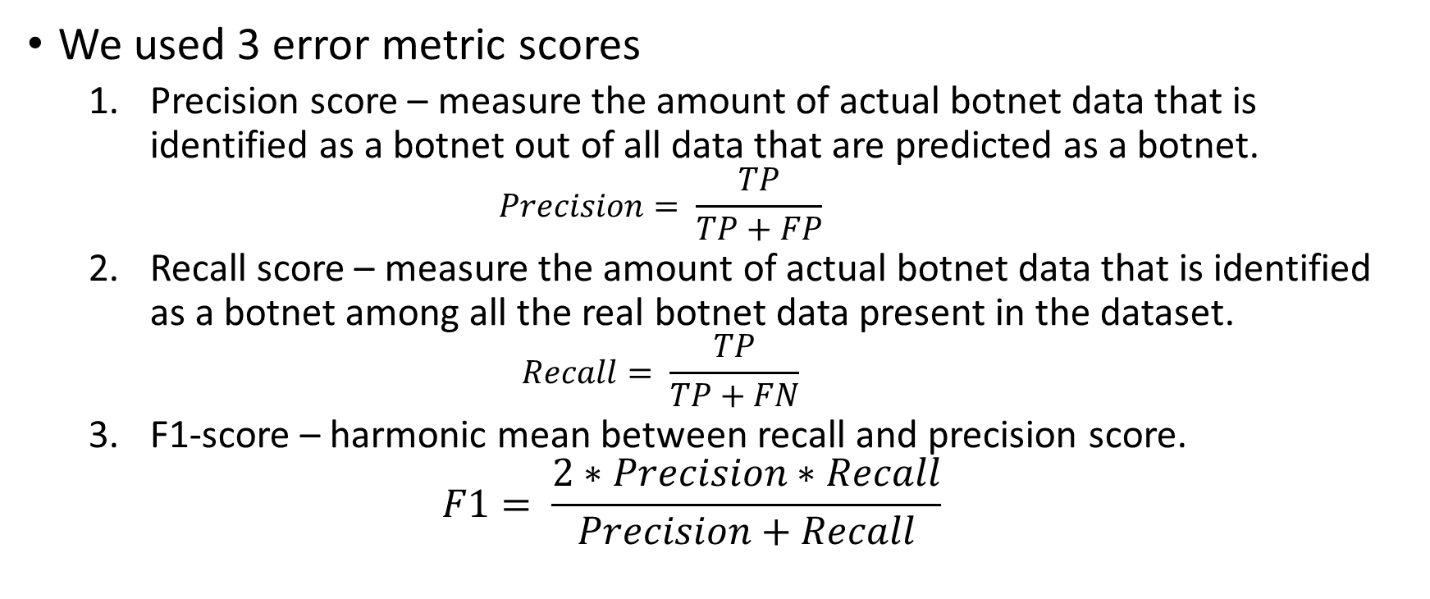
Evaluation
We used 3 error metric scores
Precision score – measure the amount of actual botnet data that is identified as a botnet out of all data that are predicted as a botnet.
$$Precision= \frac{TP}{TP+FP}$$
Recall score – measure the amount of actual botnet data that is identified as a botnet among all the real botnet data present in the dataset.
$$Recall= \frac{TP}{TP+FN}$$
F1-score – harmonic mean between recall and precision score.
$$F1= \frac{2∗Precision∗Recall}{Precision+Recall}$$

Slide 13
Experiment setup
We had used CTU13 dataset which contains 13 different scenario. We have conduct 2 experiments for each integrating technique
Known Scenario Approach
All 13 scenarios are used as input for the training process
Divide data into training set (80%) and test set (20%)
Unknown Scenario Approach
12 out of 13 scenarios are used as input for the training process and left one scenario unknown.
We had divided every scenario that was used in training process into training set (80%) and test set (20%).
For testing process, test set and an unknown scenario are used.

Slide 14
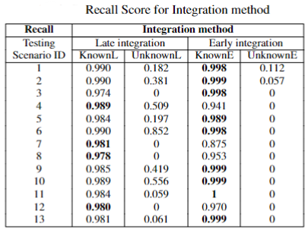
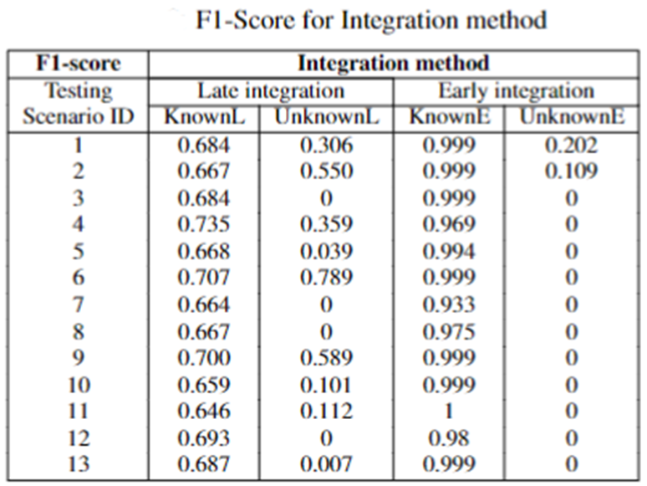
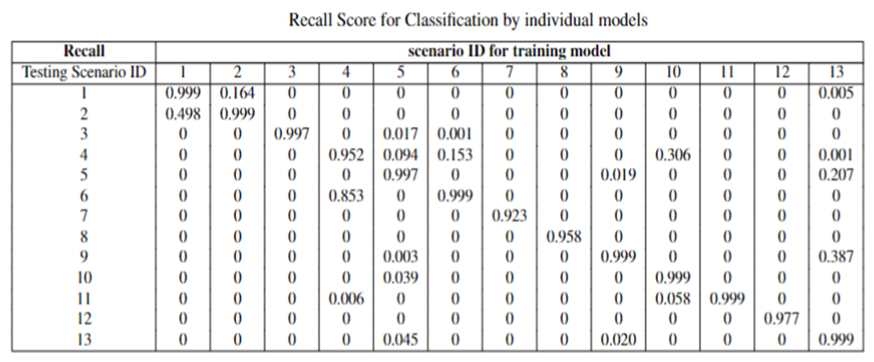
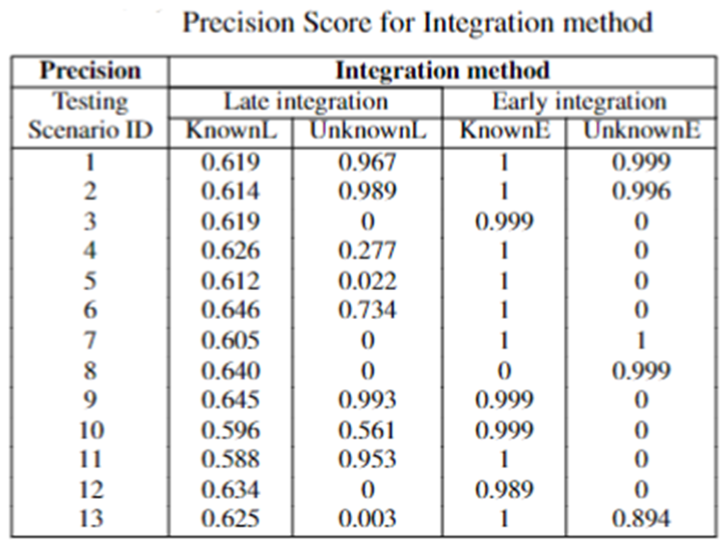
Experiment Result

Slide 15
Q & A

Slide 16
Thank you

Slide 17

Classification by individual models
Test set 1
Test set 2
Test set 3
Test set 4
Test set M
Model 1
Model 2
Model 3
Model 4
Model M
Output 1
Output 2
Output 3
Output 4
Output M

